Slide 1

MVOTI TO UMZIMKULU CLASSIFICATION STUDY
PSC
Overview of the Mvoti and Mkomazi scenarios
(Item 8.1)
26 November 2014
DWA CORPORATE IDENTITY
Presented by:
Johan Maree
Deputy Director: Media Production
12 December 2012

Slide 2
Mvoti Study integrated steps
1: Delineate units of analysis and describe the status quo
2: Initiation of stakeholder process and catchment visioning
3: Quantify EWRs
7: Gazette class configuration
4: Identification and evaluation of scenarios within IWRM
6: Resource Quality Objectives (EcoSpecs & water quality (user))
5: Draft Management Classes
Scenario Evaluation, MC determination
Notes:
Where does it fit into the process.

Slide 3
What are scenarios?
Scenarios, in context of water resource management and planning are plausible definitions (settings) of the factors (variables) that influence the water balance and water quality in a catchment and the system as a whole

Slide 4
What needs to be evaluated?
Degree of the ecological health defined by Ecological Categories of biophysical nodes (none-monetary)
Ecosystem Services (none-monetary)
Socio-Economic implications
  Monetary (GDP) and non-monetary (job count)

Slide 5
How is it rated?
Ecological consequences are rated according to the degree that the Recommended Ecological Category is met. (REC is the top of the scale.)
Ecosystem Services, present state is “1.0” with relative rating for scenarios.
Economic Indicator, in general GDP or other relevant comparative monitory indicator.
Employment, number of jobs as affected by scenario.
Integrated rank, weighted scores of above 4 variables – two methods of ranking.

Slide 6
What are scenarios used for?
Different levels of water use and protection are evaluated with the aim to find a preferred balanced scenario.
Water Resource Classification is the process to evaluate and recommend what that balance scenario entails.

Slide 7
Why Multi-Criteria Analysis?
Method to compare alternatives where the outcomes (consequences) are in different numerical terms.
Ecological consequences is a relative rating while economy is in monetary terms and employment in numbers.
Multi-Criteria Analysis is appropriate in these circumstances.
Notes:
Allocation priority (principle) in the NWA provide for legal protection of the ecology: Why?

Slide 8
Concept of Multi Criteria evaluation method
Ranked
SC for each reach / node
Ranked SC for IUA / system
For all
scenarios
Ecology
Weighting process
Score
Fish
Geom
Inverts
Phys, Chem
Rip veg
Degree of meeting REC
EGSA
Weighting process
Integrated Comparison (all variables)
Score
Food, fuel
Regulating
Cultural
Relative to present
provisions
Economy
Weighting process
Score
GDP
Jobs
Household
Income
Relative to base
condition

Slide 9
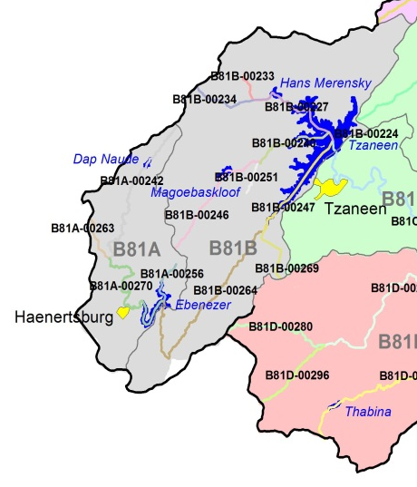
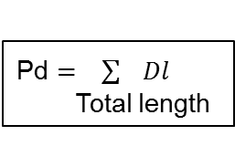
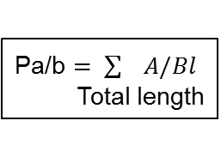
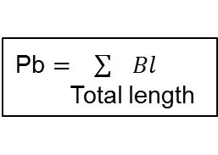
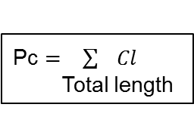
Deriving the Management Class
Ecological Categories for a Selected Scenario
(IUA 1)
River Reach | Length (km) | EC
B81A-00242 | 21.9 | C
B81A-00256 | 5.3 | D
B81A-00263 | 5.1 | D
B81A-00270 | 20.2 | C
B81B-00233 | 3.2 | C
B81B-00234 | 7.1 | C
B81B-00246 | 14.7 | C
B81B-00251 | 3.7 | D
B81B-00269 | 6.5 | B
B81B-00227 | 11.0 | D
B81B-00240 | 10.2 | C
B81B-00247 | 12.5 | C/D
EWR1 | 25.7 | C
Total length | 147.1
Pd $= \sum{Dl}$
Total length
Pc $= \sum{Cl}$
Total length
Pb $= \sum{Bl}$
Total length
Pa/b $= \sum{A/Bl}$
Total length
Management Class Criteria
 |  | % EC representation at units represented by biophysical nodes in an IUA |  |  |  |  | Prominent EC
 |  | ≥ A/B | ≥ B | ≥C | ≥ D | < D
Class I |  | 0 | 60 | 80 | 95 | 5 | A & B EC
Class II |  |  | 0 | 70 | 90 | 10 | C EC
Class III | Either |  |  | 0 | 80 | 20 | D EC
 | Or |  |  |  | 100
Management Class: I, II or III
EC - Ecological Category

Slide 10
DWA CORPORATE IDENTITY
Presented by:
Johan Maree
Deputy Director: Media Production
12 December 2012
Description of Scenarios
Mvoti River System
uMkomazi River System

Slide 11
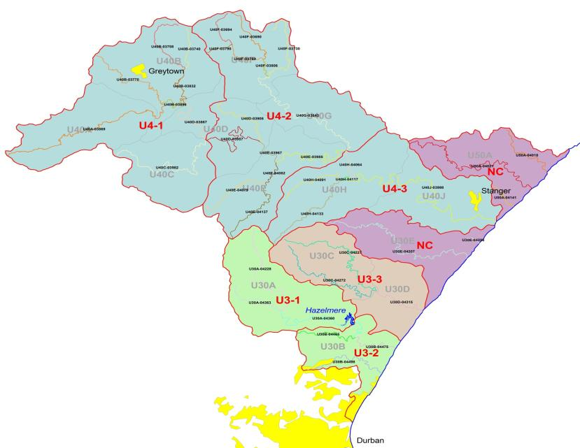
Mvoti River Catchment
Mvoti River Catchment
Storage Regulation Low
River Abstractions – reduced base flows
River management – restrict u/s to maintain supply to KwaDukuza (Stanger)
Future resource development
  IsiThundu Dam
  Imvutshane Dam

Slide 12
Water Requirements
Present Day Scenario defined from:
  Water Reconciliation Strategy Study for the KwaZulu-Natal Coastal Metropolitan Areas.
  DWA All Towns Strategies and the Water Reconciliation Strategy Study for the Kwazulu Natal Coastal Metropolitan Areas.
Ultimate Development Scenario:
  Increased water use and return flows for:
    Greytown – Long term option - groundwater abstraction, baseflow adjusted, return flows increased.
    KwaDukuza - Return flows increased (u/s estuary).
    Abstraction from the proposed Imvutshane Dam being planned by Umgeni Water, supply to Mapumulo and Maqumbi.
    Abstractions from the proposed Isithundu Dam for supply to North Coast and KwaDukuza areas.

Slide 13
Mvoti River Catchment
Scenarios | Scenario Variables
 | Ultimate Development Demands & Return Flows (2040) | EWR | Isithundu Dam | Imvutshane Dam
MV1 (PD) | No | No | No | No
MV3 | Yes | No | Yes | Yes
MV41 | Yes | REC total | Yes | Yes
MV42 | Yes | REC low | Yes | Yes
MV43 | Yes | REC low+ | Yes | Yes
Notes:
Recommended Ecological Category (REC) is to maintain the Present Ecological State (PES). Therefore no reduction in current water use activities needed to achieve REC.
Imvutshane Dam : Applied release recommendation in licence application from
“REC total” = Total EWR to meet REC requirements released from proposed Isithundu Dam.
“REC low”= Only release low flow component of REC.
“REC low+” = Release low flow component of REC and Total Flows for January, February and March.

Slide 14
Water available from future developments
Scenarios | EWR | Abstraction (million m³/annum)
 |  | IsiThundu Dam (Historical Firm Yield) | Imvutshane Dam
MV1 (PD) | No | Not applicable, no development in place.
MV3 | No | 34.9 | 4.38
MV41 | REC total | 8.1
MV42 | REC low | 15.2
MV43 | REC low+ | 13.8

Slide 15
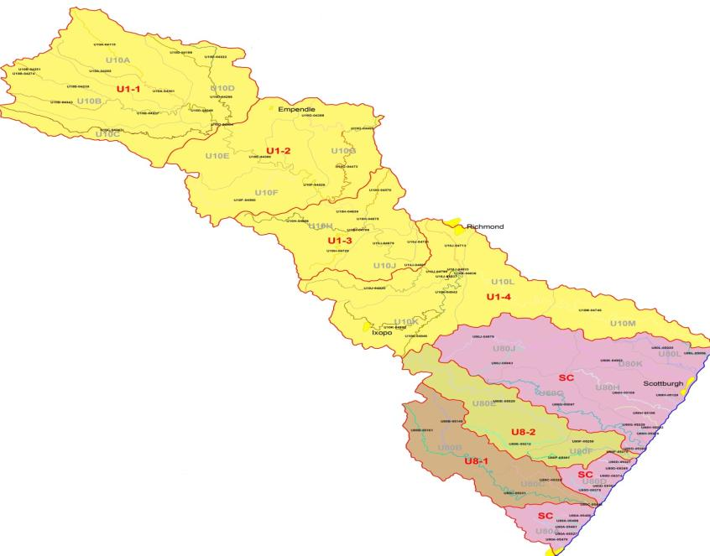
uMkhomazi River Catchment
Mzinto
None
EJ Smith
Sezela Dam
uMkhomazi River
Storage Regulation Low
Future resource development (uMkomazi Water Project-Smithfield Dam, Ngwadini Off-channel storage)

Slide 16
Water Requirements
Present Day Scenario defined from:
  Mkomazi Feasibility Study (2008 development level)
  Revised high resolution hydrology was developed.
Ultimate Development Scenario:
  Mkomazi Feasibility Study - 2040 scenario.
  Abstractions from Smithfield and Ngwadini off-channel storage dams
Water Use Sector (In-catchment) | Year
 | 2008 | 2040
Afforestation | 61.36 | 72.71
Invasive Alien Plants | 6.37 | 6.37
Irrigation | 37.70 | 51.69
Stock water | 2.86 | 3.03
Urban/Industrial | 53.00 | 57.44
Total: | 161.29 | 191.24
(Values in million m³/annum)

Slide 17
uMkhomazi River (1 of 2)
Scenarios (MK) | Scenario Variables
 | Ultimate Development (2040) | EWR |  | Smithfield Dam | Ngwadini OCD
1 | No | No |  | No | No
2 | Yes | No |  | Yes | Yes *
21 | Yes | REC tot | (EWR 2) | Yes | Yes *
22 | Yes | REC low | (EWR 2) | Yes | Yes *
23 | Yes | REC low+ | (EWR 2) | Yes | Yes *
31 | Yes | REC tot | (EWR 3) | Yes | Yes *
32 | Yes | REC low | (EWR 3) | Yes | Yes *
33 | Yes | REC low+ | (EWR 3) | Yes | Yes *
* River abstraction to Ngwadini Dam not supported by Smithfield Dam, abstract HFY.
“(EWR 2)” = Releases made from Smithfield Dam based on EWR site 2 requirements.
“(EWR 3)” = Releases made from Smithfield Dam based on EWR site 3 requirements.
Scenario 2x, 3x and 4x, releases are made for d/s users from Smithfield Dam with 10% losses.
Mainstream irrigation maintained a present reliability of supply.
Notes:
Ecological consequences were evaluated at all three EWR sites.

Slide 18
uMkhomazi River (2 of 2)
Scenarios (MK) | Scenario Variables
 | Ultimate Development (2040) | EWR | Smithfield Dam | Ngwadini OCD
4 | Yes | No | Yes | Yes (with support)
41 | Yes | REC tot (EWR 2) | Yes | Yes (with support)
42 | Yes | REC low (EWR 2) | Yes | Yes (with support)
Notes:
“(EWR 2)” = Releases made from Smithfield Dam based on EWR site 2 requirements.
“with support” = Ngwadini Dam supported from Smithfield Dam to supply 54.8 million m³/a.
Scenario 4x, EWR requirements maintained in river reach d/s of offtake to Ngwadini Dam.
General notes:
Sappi SAICCOR is supplied with EWR releases.
All scenarios maintain a minimum flow of 1 m³/s into the estuary.
“REC total” = Total EWR to meet REC requirements released from proposed IsiThundu Dam.
“REC low”= Only release low flow component of REC.
“REC low+” = Release low flow component of REC and Total Flows for January, February and March.

Slide 19
Water available from future developments
Scenarios (MK) | Scenario Variables
 | Ultimate Development (2040) | EWR |  | Smithfield Dam | Ngwadini Off-Channel Dam | Total
1 | No | No
2 | Yes | No |  | 196.0 | 12.0 | 208.0
21 | Yes | REC tot | (EWR 2) | 142.2 | 8.0 | 150.2
22 | Yes | REC low | (EWR 2) | 150.6 | 8.0 | 158.6
23 | Yes | REC low+ | (EWR 2) | 150.6 | 8.0 | 158.6
31 | Yes | REC tot | (EWR 3) | 150.1 | 6.0 | 156.1
32 | Yes | REC low | (EWR 3) | 161.0 | 6.6 | 167.6
33 | Yes | REC low+ | (EWR 3) | 161.0 | 6.6 | 167.6
4 | Yes | No |  | 142.5 | 54.8 | 197.3
41 | Yes | REC tot | (EWR 2) | 84.1 | 54.8 | 138.9
42 | Yes | REC low | (EWR 2) | 92.5 | 54.8 | 147.3
Notes:
Ecological consequences were evaluated at all three EWR sites.

Slide 20
Ultimate Wastewater Discharge Scenarios
Two possible options were put forward by eThekwini:
  Scenario 21b: Discharge of 20 Ml/day into the estuary catering for future developments in the catchments with General Standard nutrient removal.
  Additional 30 Ml/day to be transferred from the Kingsburgh Works.

Slide 21
DWA CORPORATE IDENTITY
Presented by:
Johan Maree
Deputy Director: Media Production
12 December 2012
End Overview and Scenarios

